Slide 1
The Global Business Academy
A Lighthouse Academy
in Santa Ana
Notes:
This template can be used as a starter file for a photo album.

Slide 2
Global Business Academy Professional Partners
Introducing
Notes:
----- Meeting Notes (2/25/14 16:45) -----
Who should be on board?

Slide 3
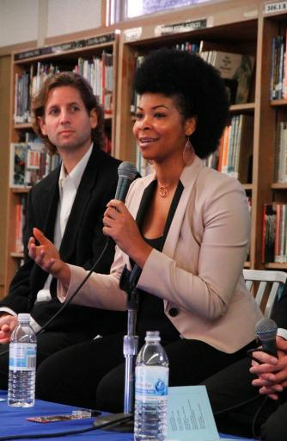
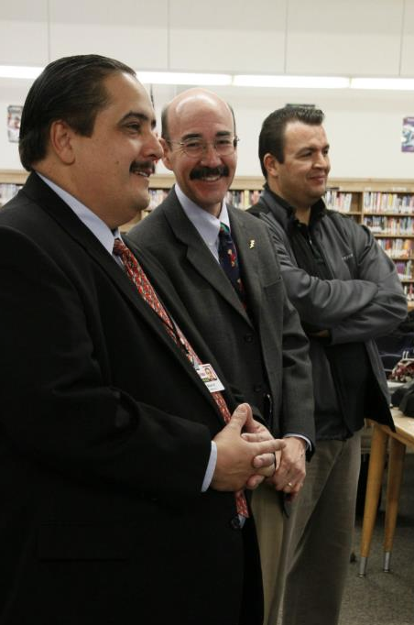
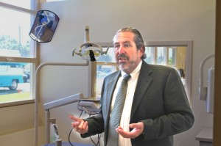
Who Should Be on the Board?
Partners
Business Partners
Teachers-ROP
Administrators/Counselor
The Academy Advisory Board is made up of adults that support the project.

Slide 4
Soliciting Interest
Professional Groups
Professional Associations
Chamber of Commerce
Community Orgs
Valley High School is linked to High School, Inc., a charter between the SAUSD and the Santa Ana Chamber of Commerce. Use your community’s local and personal strengths. What groups are in your community? Who is in your personal network?

Slide 5
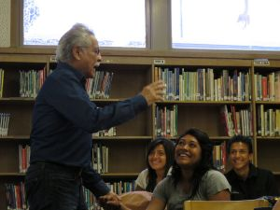
The Classroom Experience
Partner visitation schedule
Partner-initiated projects
(Partners may need guidance on classroom protocols)
Partners are given time to fully develop the project
Teacher supports projects and classroom visitations
Partners lead selection and formation of student teams
Strong SLC model provides weekly meetings with academy teachers who discuss the project as an agenda item

Slide 6
How Business Partners Think
Enjoy working with students
Student growth and acknowledgement keeps partners engaged
Partner-organized student recognition events:
Partners share in student and academy success
Picnics, potlucks, End-of- Year Recognition, Open House, professional luncheons and mixers
Challenges
Professional Expectations vs. District Protocols
Student culture/expectations vs. industry expectations

Slide 7
Partner Benefits to our Students
Soft skills
Interview coaching
Resume building
Internships
Job Opportunities
Adult mentor/model
Professional mentor in selected career
Job shadowing
Professional Networking
Career Panels

Slide 8
Benefits for Partners
Network with local professionals
Identify potential interns
ROP partnerships (e.g., Workman’s Comp paid)
Joy of mentoring
Philanthropy/community service
Professional stature:
Seen as a strong, trustworthy community member
Separates them from competition

Slide 9
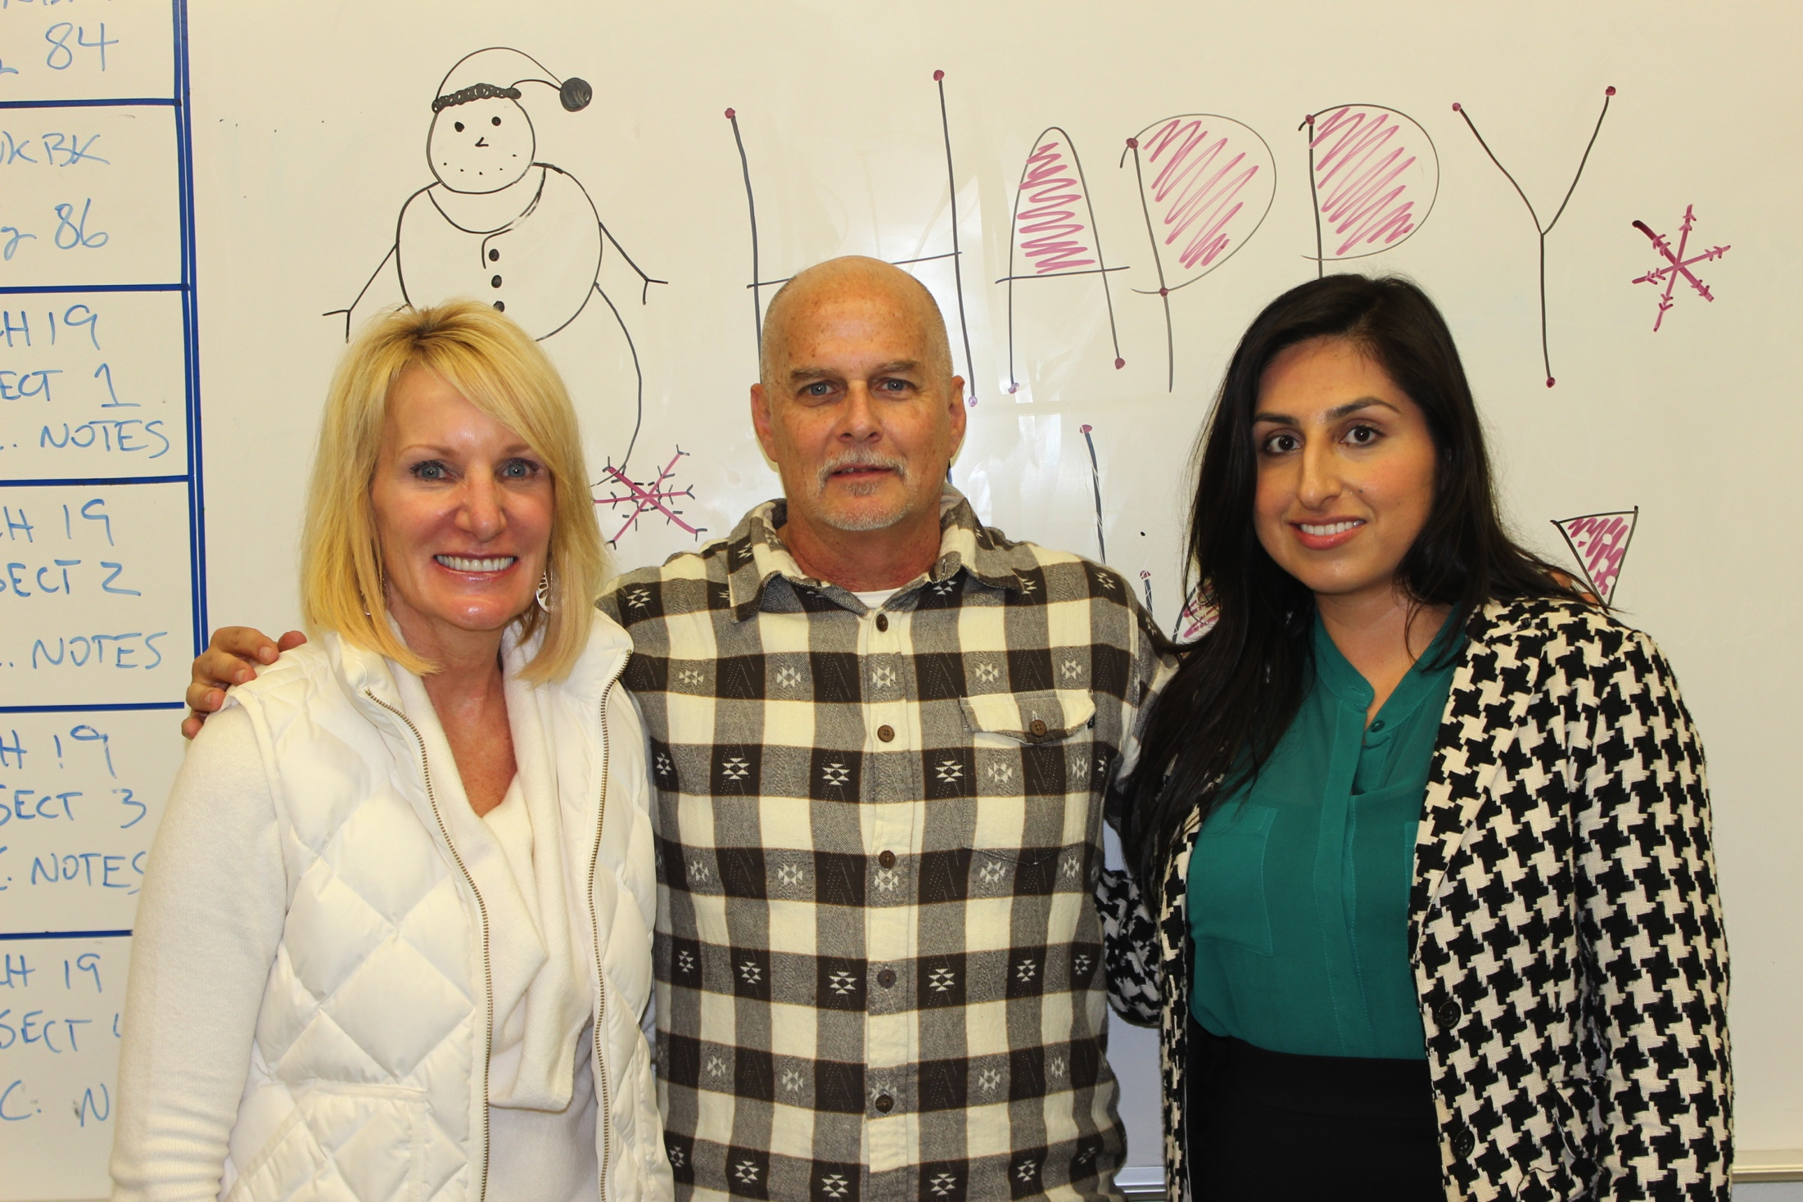
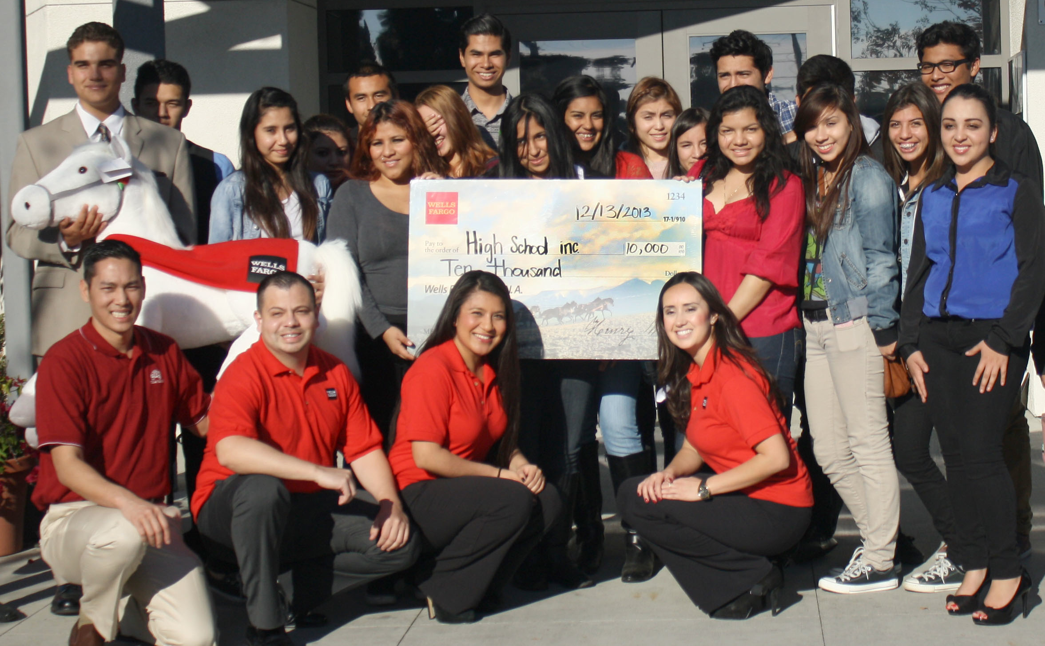
Academy Alumni as Professional Partners
Role models:
Successful professionals from the community
Transition from high school academy to university and career
Knowledge of the community:
Challenges
Traditions
Networking
Advisory board members
Commitment: life-long dedication to the academy

Slide 10
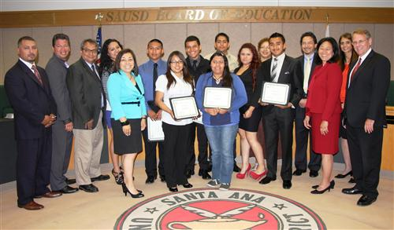
In what ways can you strengthen your own academy advisory board using the resources in your community?
Create your Action Plan now!

